Slide 1
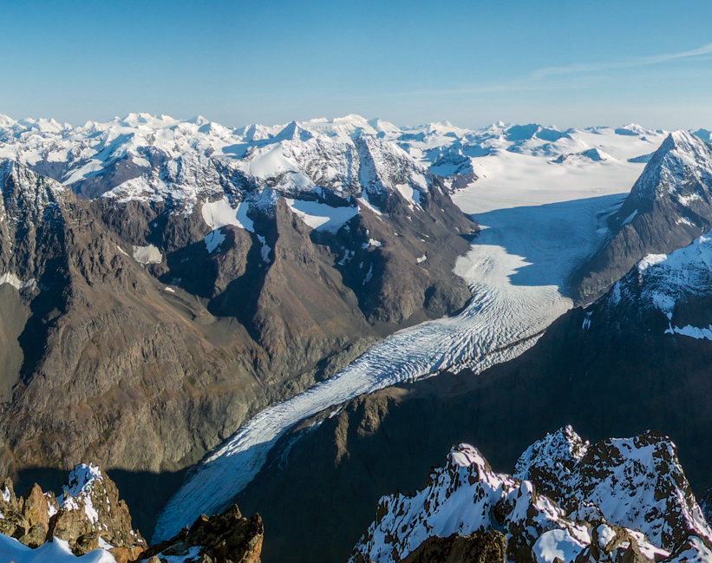



Sedimentary Analysis of Eklutna Lake, Alaska, to Understand Glacier Fluctuations Over the Past 9,600 Years
Tatum Hardt
Dr. Darrell Kaufman
Northern Arizona University
AZSGC Symposium, Tucson, AZ
April 20, 2024
Eklutna Glacier (via: AKmountain.com)

Slide 2
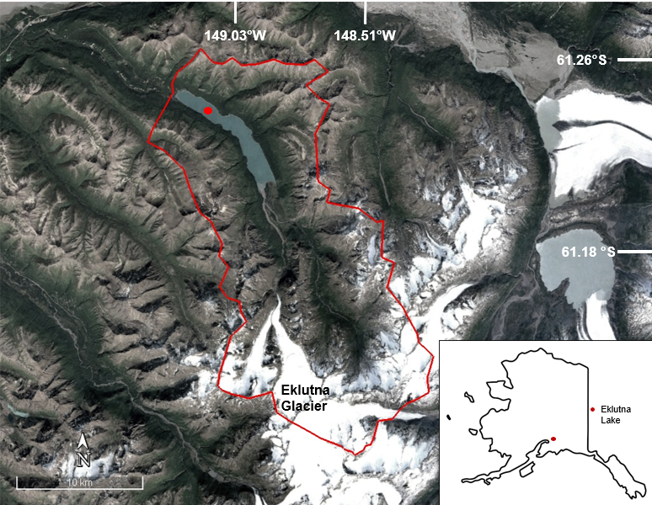
Background and Motivation
Eklutna Glacier is losing mass due to arctic warming, threatening water and hydropower to Anchorage, AK.
Proglacial lake sediment cores from Eklutna Lake provide proxies for past glacier fluctuations due to changing climatic conditions.
Notes:
Glacier is shrinking due to warming, threatening Anchorage because Eklutna lake provides water/hydropower.
Eklutna is a Proglacial lake, a bodies of water that form in front of glacier ice margins typically created from glacial melt water. Lake sediment cores taken from the lake provide geochronological dates and proxies for past fluctuations in glacier size due to changing climatic conditions.

Slide 3
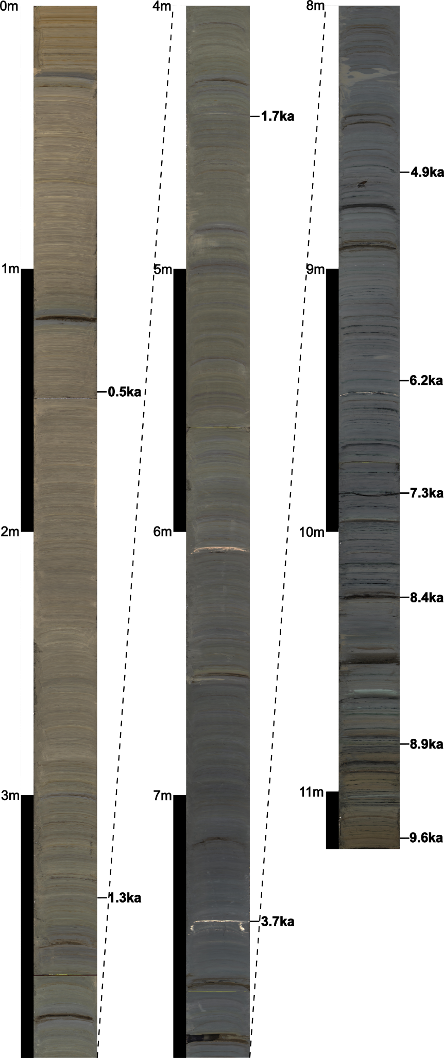
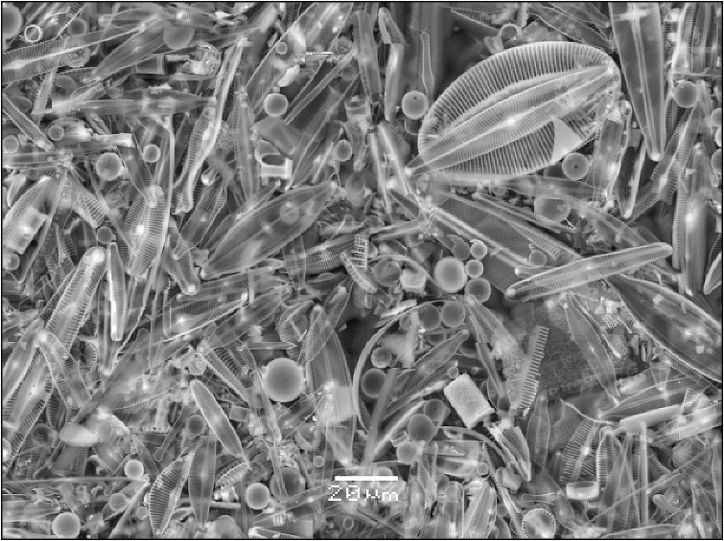
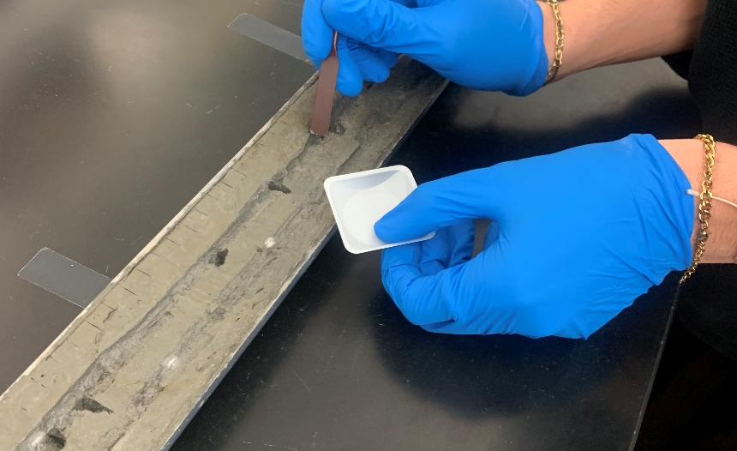
Methods
Sediment cores were retrieved in 2014 and sampled at 40-year intervals.
Sediment samples used for established biogenic silica protocols.
Organic matter content was measured using standard loss-on-ignition procedure.
Vegetation macrofossil fragments were dated using standard ¹⁴C procedures.
Fig. 2 Microscope image of purified biogenic silica comprising of diatoms (Broadman et al. 2020)
Fig. 3. Core EK14-1 being sampled in the lab.
Fig. 1 Core EK14-1
Notes:
Lake sediment cores were retrieved in 2014 in collaboration with Ghent University and the USGS
Black bands=volcanic ash, brown= soil from flood deposits
Sediment samples underwent established biogenic silica protocols, using an alkaline solution then adding a base, and using a color indicator to measure absorbance in a spectrometer.
Diatoms are single celled algae which contains silica in the cell wall, which is left behind as algae decomposes.
Organic matter using standard LOI procedures at 550 C for 1 hour.
Vegetation macrofossil fragments were picked from disaggregated sediment and dated using standard ¹⁴C procedures.

Slide 4
Results
Notes:
The age-depth model is based on calibrated 14C ages and tephras (fragments ejected from erupting volcanoes, typically ash) and developed using the Bacon model.
Used in combination, a line of best fit determined the age at various depths, as well as a max. and min. age bracket
Age model dated BSi, OM, and sedimentation rates
BSi and OM are significantly correlated (p=4.79E-6). BSi and OM content are higher at the base of the core (before 5 ka) and lower at the top of the core (after 5 ka). Sedimentation rate appears to have an inverse relationship, being lower before 5 ka and larger thereafter.
A compilation of data published in a 2016 paper, composed of individually dated moraines in the region, primarily appear ins after 5 ka, as represented by the data points. Similarly, advances during the first millennium and three-part Little Ice Age represent numerous moraines deposited in the region.“
A moraine is the rock and soil left behind from moving glaciers. Moraines are used to determine when glaciers reached their maximum extent because moraines mark the glacier terminus.

Slide 5
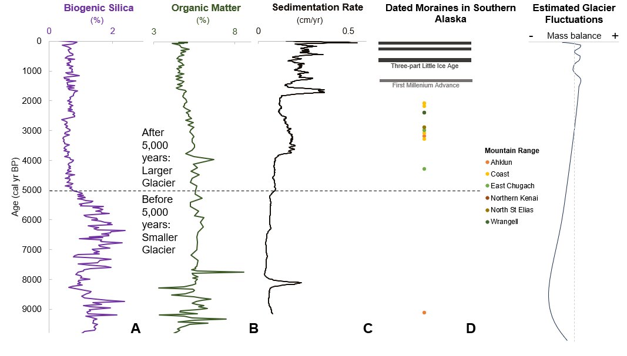
Results
Notes:
The age-depth model is based on calibrated 14C ages and tephras (fragments ejected from erupting volcanoes, typically ash) and developed using the Bacon model.
Used in combination, a line of best fit determined the age at various depths, as well as a max. and min. age bracket
Age model dated BSi, OM, and sedimentation rates
BSi and OM are significantly correlated (p=4.79E-6). BSi and OM content are higher at the base of the core (before 5 ka) and lower at the top of the core (after 5 ka). Sedimentation rate appears to have an inverse relationship, being lower before 5 ka and larger thereafter.
A compilation of data published in a 2016 paper, composed of individually dated moraines in the region, primarily appear ins after 5 ka, as represented by the data points. Similarly, advances during the first millennium and three-part Little Ice Age represent numerous moraines deposited in the region.“
A moraine is the rock and soil left behind from moving glaciers. Moraines are used to determine when glaciers reached their maximum extent because moraines mark the glacier terminus.

Slide 6
Results
Notes:
The age-depth model is based on calibrated 14C ages and tephras (fragments ejected from erupting volcanoes, typically ash) and developed using the Bacon model.
Used in combination, a line of best fit determined the age at various depths, as well as a max. and min. age bracket
Age model dated BSi, OM, and sedimentation rates
BSi and OM are significantly correlated (p=4.79E-6). BSi and OM content are higher at the base of the core (before 5 ka) and lower at the top of the core (after 5 ka). Sedimentation rate appears to have an inverse relationship, being lower before 5 ka and larger thereafter.
A compilation of data published in a 2016 paper, composed of individually dated moraines in the region, primarily appear ins after 5 ka, as represented by the data points. Similarly, advances during the first millennium and three-part Little Ice Age represent numerous moraines deposited in the region.“
A moraine is the rock and soil left behind from moving glaciers. Moraines are used to determine when glaciers reached their maximum extent because moraines mark the glacier terminus.

Slide 7
Results
Notes:
The age-depth model is based on calibrated 14C ages and tephras (fragments ejected from erupting volcanoes, typically ash) and developed using the Bacon model.
Used in combination, a line of best fit determined the age at various depths, as well as a max. and min. age bracket
Age model dated BSi, OM, and sedimentation rates
BSi and OM are significantly correlated (p=4.79E-6). BSi and OM content are higher at the base of the core (before 5 ka) and lower at the top of the core (after 5 ka). Sedimentation rate appears to have an inverse relationship, being lower before 5 ka and larger thereafter.
A compilation of data published in a 2016 paper, composed of individually dated moraines in the region, primarily appear ins after 5 ka, as represented by the data points. Similarly, advances during the first millennium and three-part Little Ice Age represent numerous moraines deposited in the region.“
A moraine is the rock and soil left behind from moving glaciers. Moraines are used to determine when glaciers reached their maximum extent because moraines mark the glacier terminus.

Slide 8
Results
Notes:
The age-depth model is based on calibrated 14C ages and tephras (fragments ejected from erupting volcanoes, typically ash) and developed using the Bacon model.
Used in combination, a line of best fit determined the age at various depths, as well as a max. and min. age bracket
Age model dated BSi, OM, and sedimentation rates
BSi and OM are significantly correlated (p=4.79E-6). BSi and OM content are higher at the base of the core (before 5 ka) and lower at the top of the core (after 5 ka). Sedimentation rate appears to have an inverse relationship, being lower before 5 ka and larger thereafter.
A compilation of data published in a 2016 paper, composed of individually dated moraines in the region, primarily appear ins after 5 ka, as represented by the data points. Similarly, advances during the first millennium and three-part Little Ice Age represent numerous moraines deposited in the region.“
A moraine is the rock and soil left behind from moving glaciers. Moraines are used to determine when glaciers reached their maximum extent because moraines mark the glacier terminus.

Slide 9
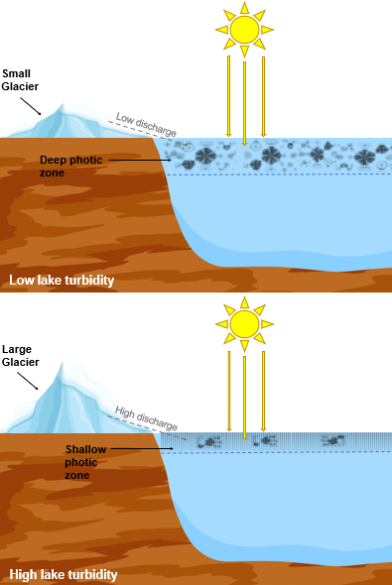
Discussion
Before 5,000 years ago, Eklutna Glacier was smaller:
High diatom productivity due to low lake turbidity
Low sediment accumulation rate
After 5,000 years ago, Eklutna Glacier grew larger:
Low diatom productivity due to turbid water
Elevated sediment accumulation rate
Image via Alaska Daily News
Notes:
Smaller glaciers generate little rock flour (which is mechanically grinded from bedrock as glaciers flow downslope) because they have less mass.
Little rock flour input reduces lake turbidity, which deepens the photic zone because less sunlight is blocked, creating an ideal environment for diatom growth.
Large glaciers generate more rock flour because they have more mass, creating turbid conditions.
More rock flour input in the lake blocks sunlight, reducing the depth of the photic zone, limiting conditions for diatom growth.
Our data aligns with glacier expansion observed in southern AK after 5 ka, based on reconstructed temperature records and dated moraines.

Slide 10
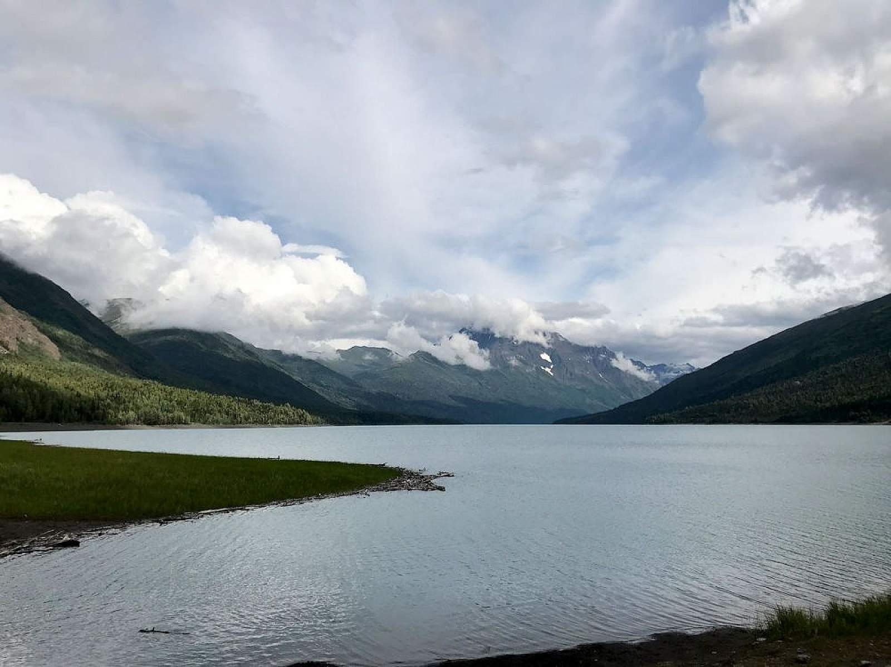
Conclusion
Using proxies to understand how glaciers responded to past changes in climatic conditions can help us predict how glaciers may respond to future changes.
Future research is necessary to predict and understand how high latitude lakes will be affected by human-induced warming.
Eklutna Lake (via Alaska.org)
Notes:
Proxies in proglacial lake sediment can be used to understand how glaciers responded to past changes in climatic conditions and infer how they may respond to projected changes in the future.
Future research is needed to understand how high latitude lakes will be affected by human induced warming because the arctic is predicted to experience acute warming affects.

Slide 11
Acknowledgements
Dr. Darrell Kaufman for his mentorship and guidance throughout the project, as well as data interpretation.
Dr. Jordan Bright for lab work guidance and data interpretation.
Dr. Maurycy Zarczynski for statistical analysis and interpretation in R.
Hunter Allen for data interpretation.
Cedar Bertelsen, Michelle Olichney, and Meriel Medina for sample processing.
The NASA Space Grant and the National Science Foundation for project funding.

Slide 12
Thank you!

